Slide 1
Chapter 1: Problem Solving with Mathematical Models
A mathematical model is the collection of variables and relationships needed to describe pertinent( 相关的) features of real problems
Operations research(O.R.) is the study of how to form mathematical models of complex engineering and management problems and how to analyze them to gain insight about possible solutions.

Slide 2
1.1 OR Application stories
Example 1.1 Mortimer Middleman
Mortimer Middleman (MM) operates a modest wholesale diamond business. Several times each year MM travels to Antwerp, Belgium, to replenish his diamond supply on the international market. The wholesale price there average approximately $700 per carat, but Antwerp market rules require him to buy at least 100 carats each trip . Mortimer and his staff then resell the diamonds to jewelers at a profit $200 per carat. Each of the Antwerp trips requires 1 week, including the time for Mortimer to get ready, and costs approximately $2000.
Customer demand values in Figure1.1(a) show that business has been good. Over the past year, customers have come in to order an average of 55 carats per week.

Slide 3
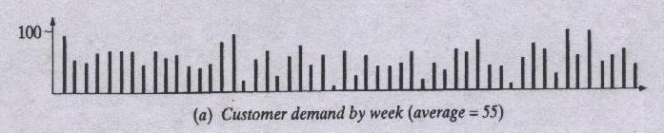
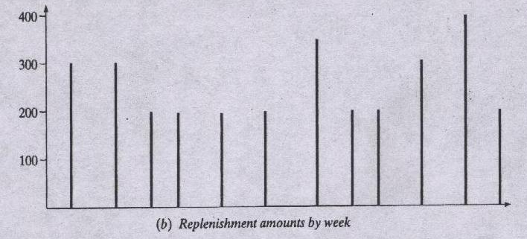

Slide 4
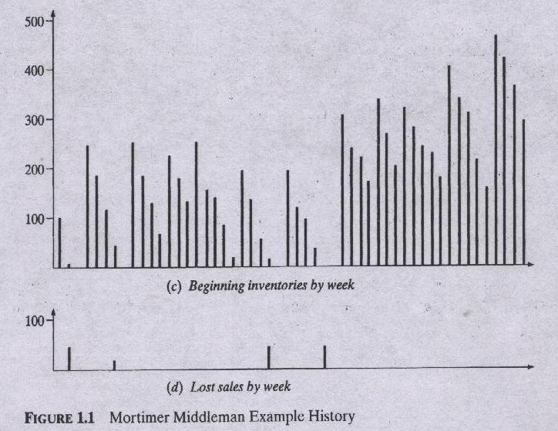

Slide 5
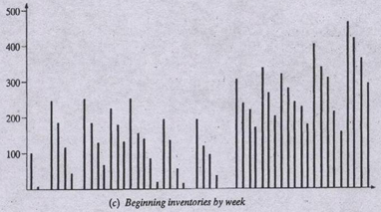
Part(c) of Figure1.1 illustrates Mortimer`s problem. Weekly levels of on-hand diamond inventory have varied widely, depending on the ups and downs in sales and the pattern of MM’s replenishment trips[figure1.1(b)]

Slide 6
Sometimes Mortimer believes that he is holding too much inventory . The hundreds of carats of diamonds on hand during some weeks add to his insurance costs and tie up capital that he could otherwise invest.
MM has estimated that these holding costs total 0.5% of wholesale value per week(i.e. 0.005×$700=$3.5 per carat per week)

Slide 7

At other times, diamond sales-and Mortimer’s $200 per carat profit-have been lost because customer demand exceeded available stock[figure1.1(d)]. When a customer calls, MM must either fill the order on the spot or lose the sale.

Slide 8
Adding this all up for the past year, MM estimates holding costs of $38,409, unrealized profits from lost sales of $31,600, and resupply travel costs of $24,000,making the annual total $94,009. Can he do better?

Slide 9
1.2 Optimization and The OR Process
OR deals with decision problems like that of MM by formulating and analyzing mathematical models. When OR is used to solve a problem of an organization, the following seven step procedure should be followed:
modeling
problem
model
assessment
analysis
decisions
conclusions
inference

Slide 10
Step 1 Formulation or modeling.
Step1.1: OR analyst first defines the organization's problem. Defining the problem includes specifying the organization's objectives and the parts of the organization (or system) that must be studied before the problem can be solved.
Step 1.2: Next, the analyst collects data to estimate the values of parameters that affect the organization's problem. These estimates are used to develop (in Step 1.3) and evaluate (in Step 2) a mathematical model of the organization's problem.
Step 1.3: The analyst, then, develops a mathematical model (in other words an idealized representation) of the problem. In this class, we describe many mathematical techniques that can be used to model systems.

Slide 11
Step 2 Analysis and conclusions
2.1 The analyst now tries to determine if the mathematical model developed in Step 1.3 is an accurate representation of reality. To determine how well the model fits reality, one determines how valid the model is for the current situation.
2.2 Given a model and a set of alternatives, the analyst chooses the alternative (if there is one) that best meets the organization's objectives. Sometimes the set of alternatives is subject to certain restrictions and constraints. In many situations, the best alternative may be impossible or too costly to determine.
2.3 The analyst presents the model and the recommendations from Step 2.2 to the decision making individual or group. In some situations, one might present several alternatives and let the organization choose the decision maker(s) choose the one that best meets her/his/their needs.

Slide 12
Step 3 Decisions and assessment
After presenting the results of the OR study to the decision maker(s), the analyst may find that s/he does not (or they do not) approve of the recommendations. This may result from incorrect definition of the problem on hand or from failure to involve decision maker(s) from the start of the project. In this case, the analyst should return to Step 1.
If the decision maker(s) has accepted the study, the analyst aids in implementing the recommendations. The system must be constantly monitored (and updated dynamically as the environment changes) to ensure that the recommendations are enabling decision maker(s) to meet her/his/their objectives.

Slide 13
Decisions, Constraints, and Objectives
The three fundamental concerns in forming operations research models are
(a) the decisions open to decision makers,
(b) the constraints limiting decision choices, and
(c) the objectives making some decisions preferred to others.
Consider MM’s (inventory management) problem,
clearly, Mortimer is the decision maker.
What decisions does he get to make?

Slide 14
Actually, MM makes hundreds of decisions each year about when to replenish his stock and how much to buy.
It is common in inventory management circumstances such as MM’s to reduce the question to two policy decisions:
What reorder point level of inventory should trigger
a decision to buy new stock, and what order quantity
should be purchased each time?
---- these two variables constitute our decisions.

Slide 15
Next issue is constraints. What restrictions limit MM’s decision choices?
The third element is objectives. What makes one decision better than another?
Verbal model/ word description:
to choose a nonnegative reorder point and a nonnegative reorder quantity to minimize the sum of holding, replenishment, and lost-sales subject to the reorder quantity being at least some constant, for example, 100.

Slide 16
Optimization and Mathematical Programming
Optimization models(also called mathematical programs) represent problem choices as decision variables and seek values that maximize or minimize objective functions of the decision variables subject to constraints on variable values expressing the limits on possible decision choices.

Slide 17
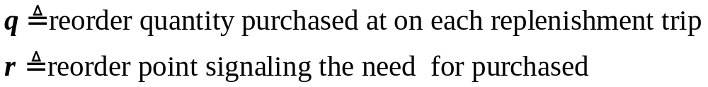
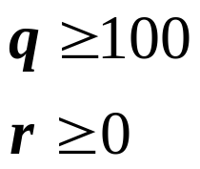
With our MM example, the decision variables are:
Constraints are:
Objective function:

Slide 18
Constant-rate demand assumption
How we formulate constraints and objectives in terms of decision variables depends on what assumptions we are willing to make about the underlying system.
In MM example, we use a strong assumption regarding constant-rate demand: Assume that demand occurs at a constant rate of 55 carats per week.
If the demand rate is constant, the pattern of on-hand inventory implied by a particular q and r will take one of the periodic “saw tooth” forms illustrate in Figure1.3.

Slide 19
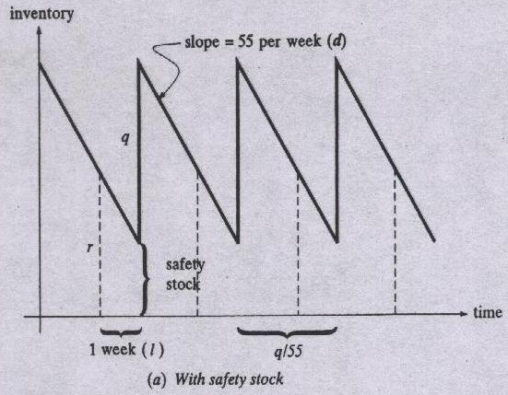

Slide 20
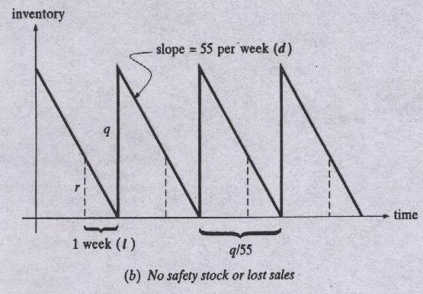

Slide 21
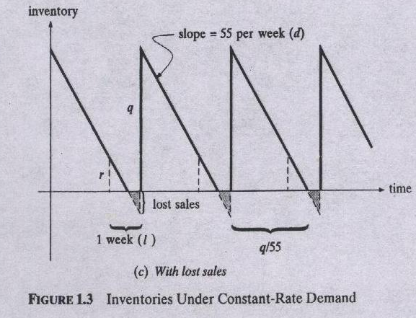

Slide 22
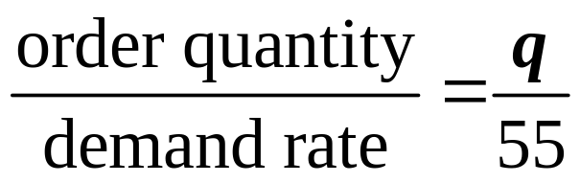
Back of envelope analysis
In case where there are no lost sales, it is easy to compute the length of each sawtooth cycle
With lost sales, each cycle is extended by a period when MM is out of stock that depends on both q and r.
Clearly, both modeling and analysis would be easier if we could ignore the lost sale case.
Can we afford to neglect lost sales?

Slide 23
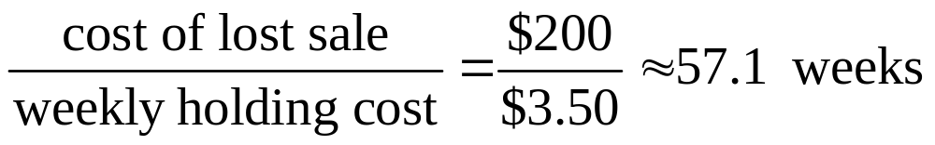
Lost sales may occur under the best of plans because of week-to-week variation in demand.
Under our constant-rate demand assumption, however, there is no variation. Furthermore, MM can afford to add a unit to q and carry it for up to
rather than lose a carat of sales.
Since the history in Figure1.1shows that inventory typically has been held no more than 4 to 6 weeks, it seems safe to make a second assumption regarding no lost sales: Assume that lost sales are not allowed.

Slide 24
Constant-rate demand model
Since customers order a constant-rate 55 carats during the 1week it takes Mortimer to carry out an Antwerp trip, both inventory at order arrival and lost sales can be computed by comparing 55 to r:
If r<55, we lost (55-r) carats of sales each cycle, under our no lost sales assumption, this will not to be permitted, then we must have r≥55
and the total costs is c=3.50[(r-55)+q/2]+2000/(q/55)
((r-55)+q/2 is a midpoint values in each cycle.)
Then our optimization model is
Minimize c=3.50[(r-55)+q/2]+2000/(q/55)
Subject to q≥100,r≥ 55
Notes:
R-55 is the safety stock

Slide 25
Feasible and Optimal solutions
A feasible solution is a choice of values for the decision variables that satisfies all constraint.
Optimal solutions are feasible solutions that achieve objective function value(s) as good as those of any other feasible solutions.
For MM’s example, q=200, r=100 is feasible solution, but not an optimal solution, because q=200, r=55 with lower cost.
It is easy to see in any optimal solution, r*=55

Slide 26
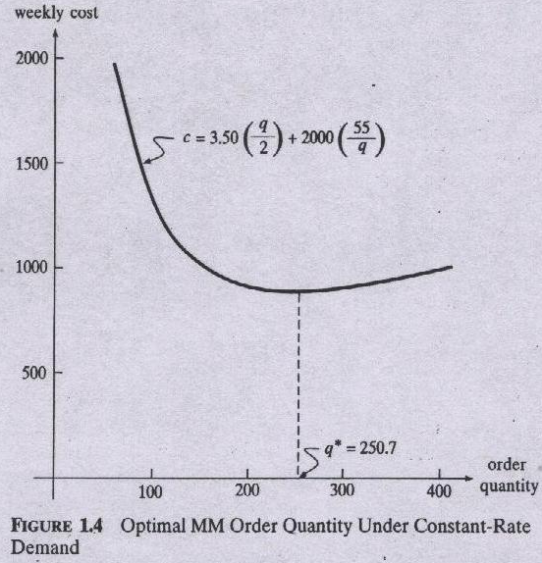
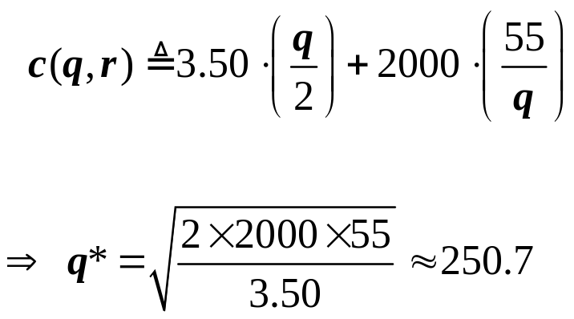
now objective function
reduces to

Slide 27
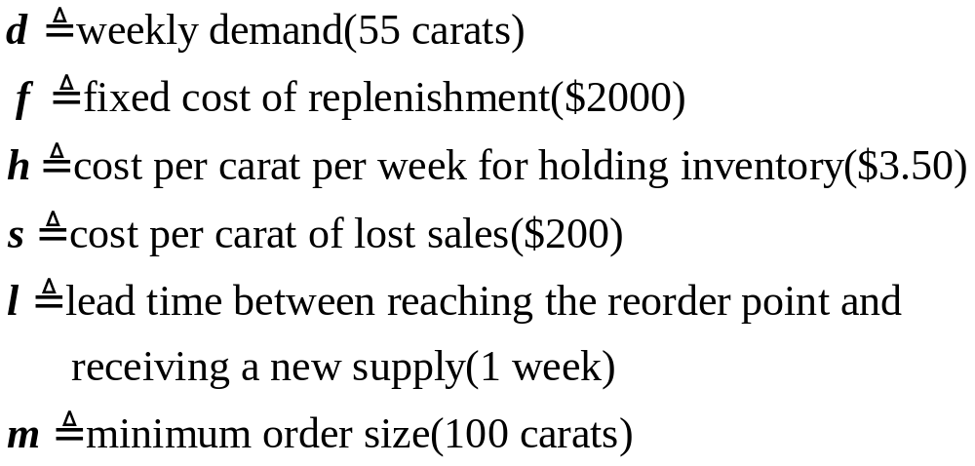
EOQ under constant-rate demand
In our constant-rate demand model of MM’s problem , only cost c is an output variable.
Parameters are:

Slide 28
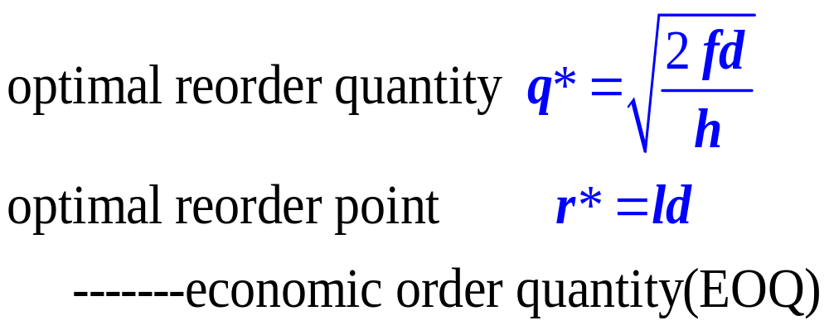
Use the above parameters, we have the optimal reorder quantity and optimal reorder point are: The
These results holds as long as q*≥m(to be general, we
also need to specify q*≥ld

Slide 29
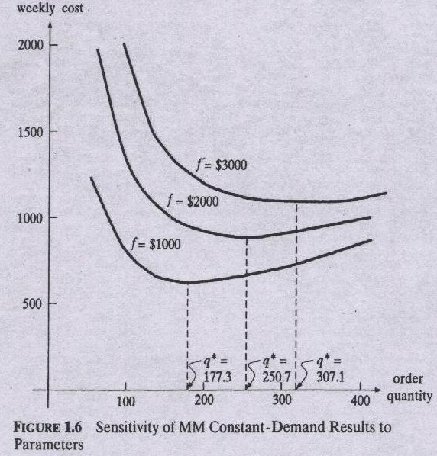
System boundaries and sensitivity analysis

Slide 30
Sensitivity analysis is an exploration of results from mathematical models to evaluate how they depend on the values chosen for parameters.
Closed-Form Solutions
Solutions prescribing choices for decision variables by simple formulas in the input variables are called closed-form
Closed-form solutions represent the ultimate in analysis of mathematical models because they provide both immediate results and rich sensitivity analysis.

Slide 31
Tractability versus Validity
Tractability in modeling means the degree to which the model admits convenient analysis--how much analysis is practical.
The validity of a model is the degree to which inferences drawn from the model hold for the real system.
OR analysts almost always confront a trade-off between validity of models and their tractability to analysis.

Slide 32
1.4 descriptive models and simulation
Simulation over MM’ history
A simulation model is a computer program that simply steps through the behavior of a system of interest and reports experience.
Simulation model validity
Simulation models often possess high validity because they track true system behavior fairly accurately.

Slide 33
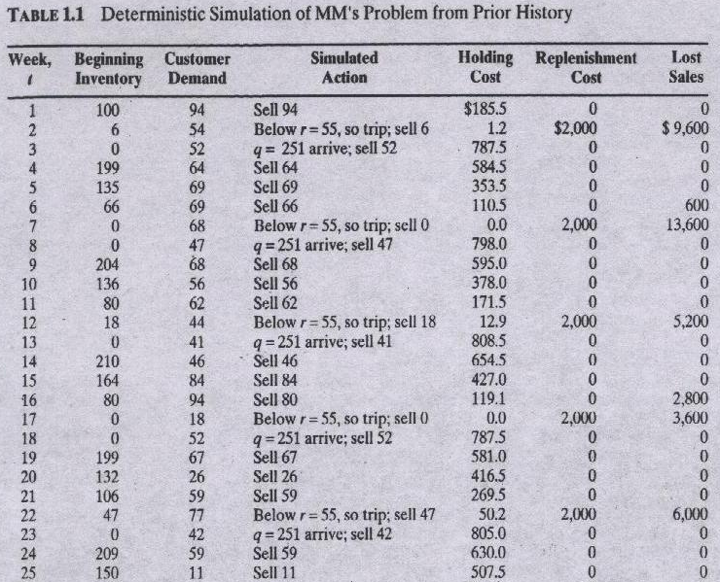

Slide 34
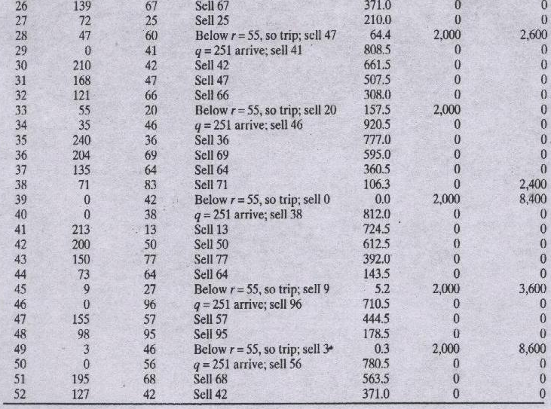

Slide 35
Simulation models often possess high validity because they track true system behavior fairly accurately
However, the simulation was also based on some assuptions.
future demand exactly mirror last year’s experience.

Slide 36
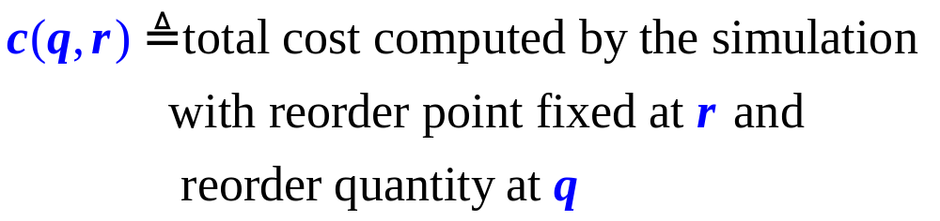
1.5 Numerical search and exact versus Heuristic solutions
The simulation in section 1.4 provided a computer program for estimating the total inventory cost associated with a particular choice of reorder point and reorder quantity.
Suppose we think of that computation as a function c(q, r). That is, for any given q and r

Slide 37
MM’s problem then reduces to
minimize c(q,r)
s.t. q≥100, r≥0

Slide 38
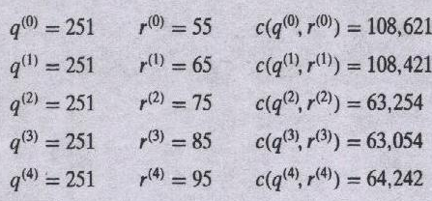
Numerical search
Numerical search is the process of systematically trying different choices for the decision variables keeping track of the feasible one with the best objective function value found so far.
For MM’s example

Slide 39
All these (q^{(t)},r^{(t)}) are feasible. Proceeding from one of the best, r=85, we now try changing q. Increasing gives
and decreasing yields
Both are worse than (q⁽³⁾,r⁽³⁾), so we terminate the
search.

Slide 40
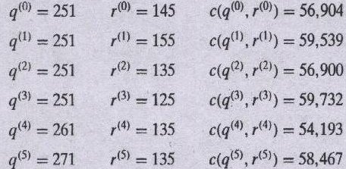
A different start
Lacking any information on how much MM’s costs might be reduced, our only way of learning more with numerical search is to try a new search from a different initial point. Consider the search sequence:

Slide 41
Inferences from numerical search are limited to the specific points explored unless mathematical structure in the model supports further deduction.

Slide 42
Exact versus heuristic optimization
An exact optimal solution is a feasible solution to an optimization model that is provably as good as any other in objective function value.
A heuristic or approximate optimum is a feasible solution derived from prescriptive analysis that is not guaranteed to yield an exact optimum.
Losses from settling for heuristic instead of exact optimal solutions are often dwarfed(显得微小) by variations associated with questionable model assumptions and doubtful data.
The appeal of exact optimal solutions is that they provide both good feasible solutions and certainty about what can be achieved under a fixed set of model assumptions.

Slide 43
1.6 Deterministic and Stochastic Models
A mathematical model is termed deterministic if all parameter values are assumed to be known with certainly
A mathematical model is termed probabilistic or stochastic if it involves quantities known only in probability.
for example : the reorder quality q depends on the demand of market which is a stochastic variable.

Slide 44
homework
Chapter 1:
pp. 20 : 1.3 1.4

